Slide 1


AQI Prediction
Model
Presented by Career Craaft

Slide 2

Introduction
Air quality is a critical factor impacting public health and the environment.
This project aims to predict the Air Quality Index (AQI) using supervised learning models.
By leveraging historical air quality data along with real time data, the model will assist in forecasting pollution levels, enabling better decision-making and proactive measures.

Slide 3

Methodology
Data Collection
Gathered real-time air quality data from CPCB monitoring stations across India
Time period: June 2023 to January 2025
Parameters include PM2.5, PM10, NO2, CO, SO2, and other pollutants
Data Preprocessing
Cleaned missing values and handled 'NA' entries
Standardized features using StandardScaler
Selected five key pollutants through correlation analysis
Model Development
Implemented Random Forest Regressor (500 estimators, max depth 20)
Focused on key features: PM2.5, PM10, NO2, CO, and SO2
Trained model on complete dataset for robust predictions
Web Application Development
Built interactive interface using Streamlit framework
Created dual functionality: AQI prediction and data analysis
Integrated Plotly Express for dynamic data visualizations
Deployment
Deployed on Streamlit Cloud platform
Implemented modular structure for maintainability
Created user-friendly interface with real-time prediction capabilities

Slide 4
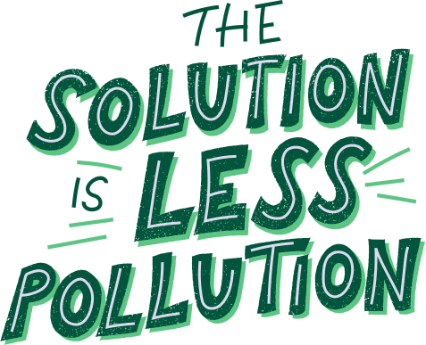

Proposed solutions
01.
AQI Predictor - we made a machine learning model using Random Forest and used it for predicting the aqi values based on user input
02.
Data Analysis Dashboard - A dashboard to visualise and analyse all your data.

Slide 5
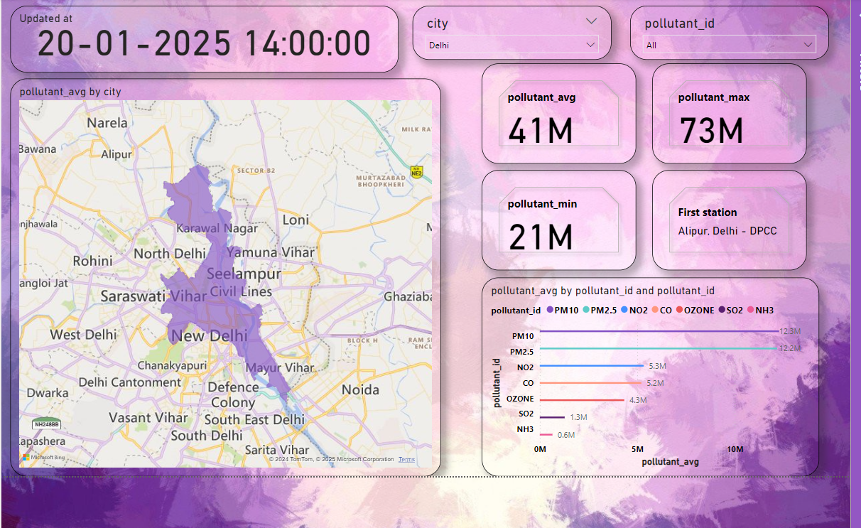
Visualization

Slide 6
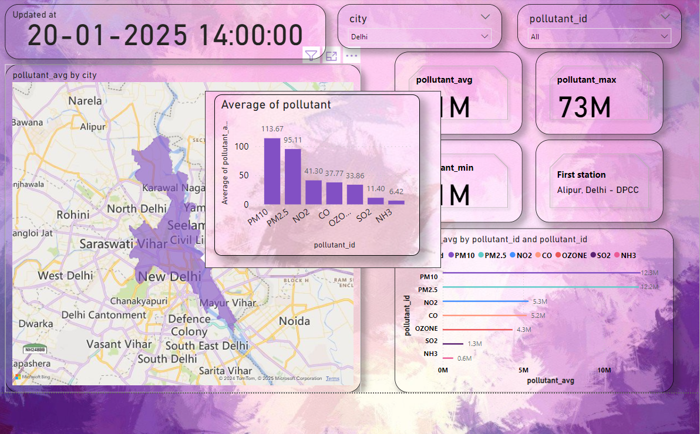

Slide 7
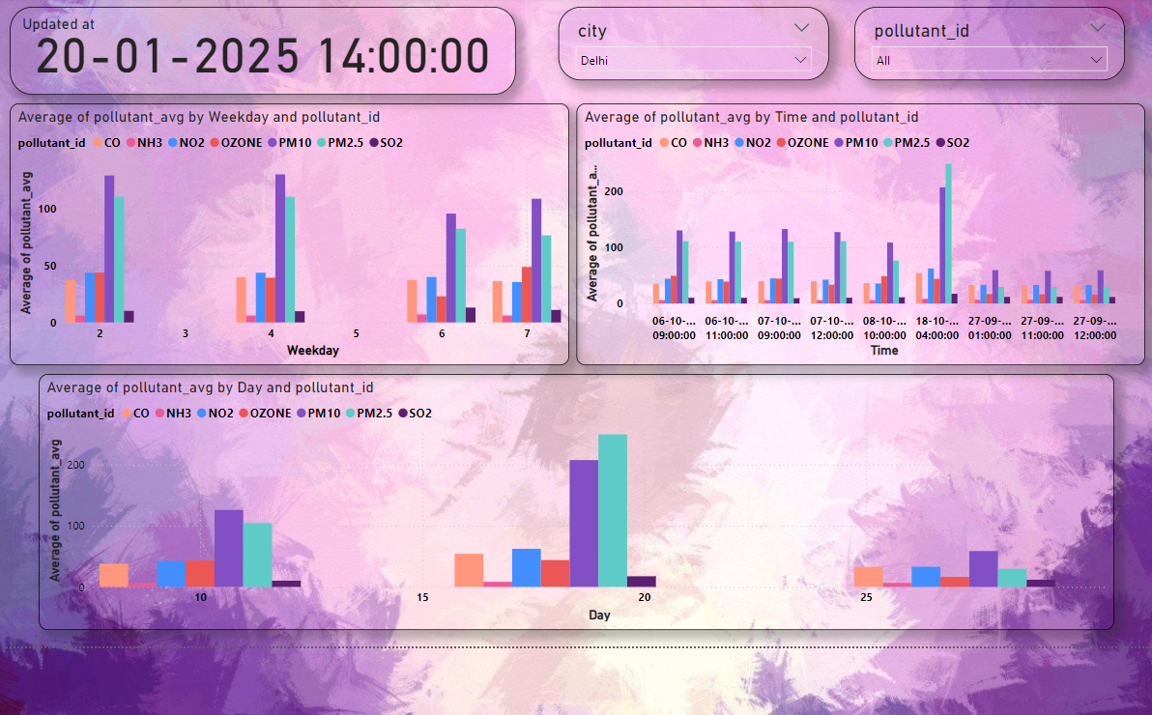

Slide 8
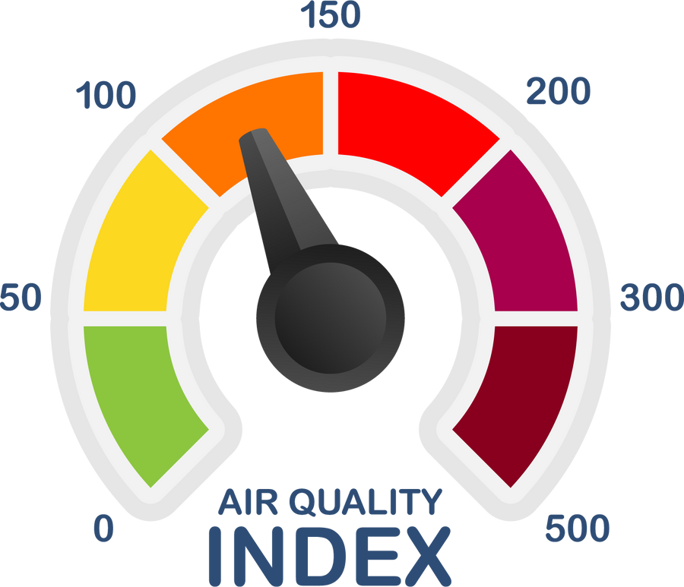

The Model
1.Model Architecture
Random Forest Regressor with 500 trees
Maximum depth of 20 levels
2.Input Parameters
Five critical air pollutants (PM2.5, PM10, NO2, CO, SO2)
StandardScaler for feature normalization
Real-time input validation and processing
3.Performance Metrics
Accuracy threshold within 10% of actual AQI values
Model trained on comprehensive dataset of Indian cities

Slide 9
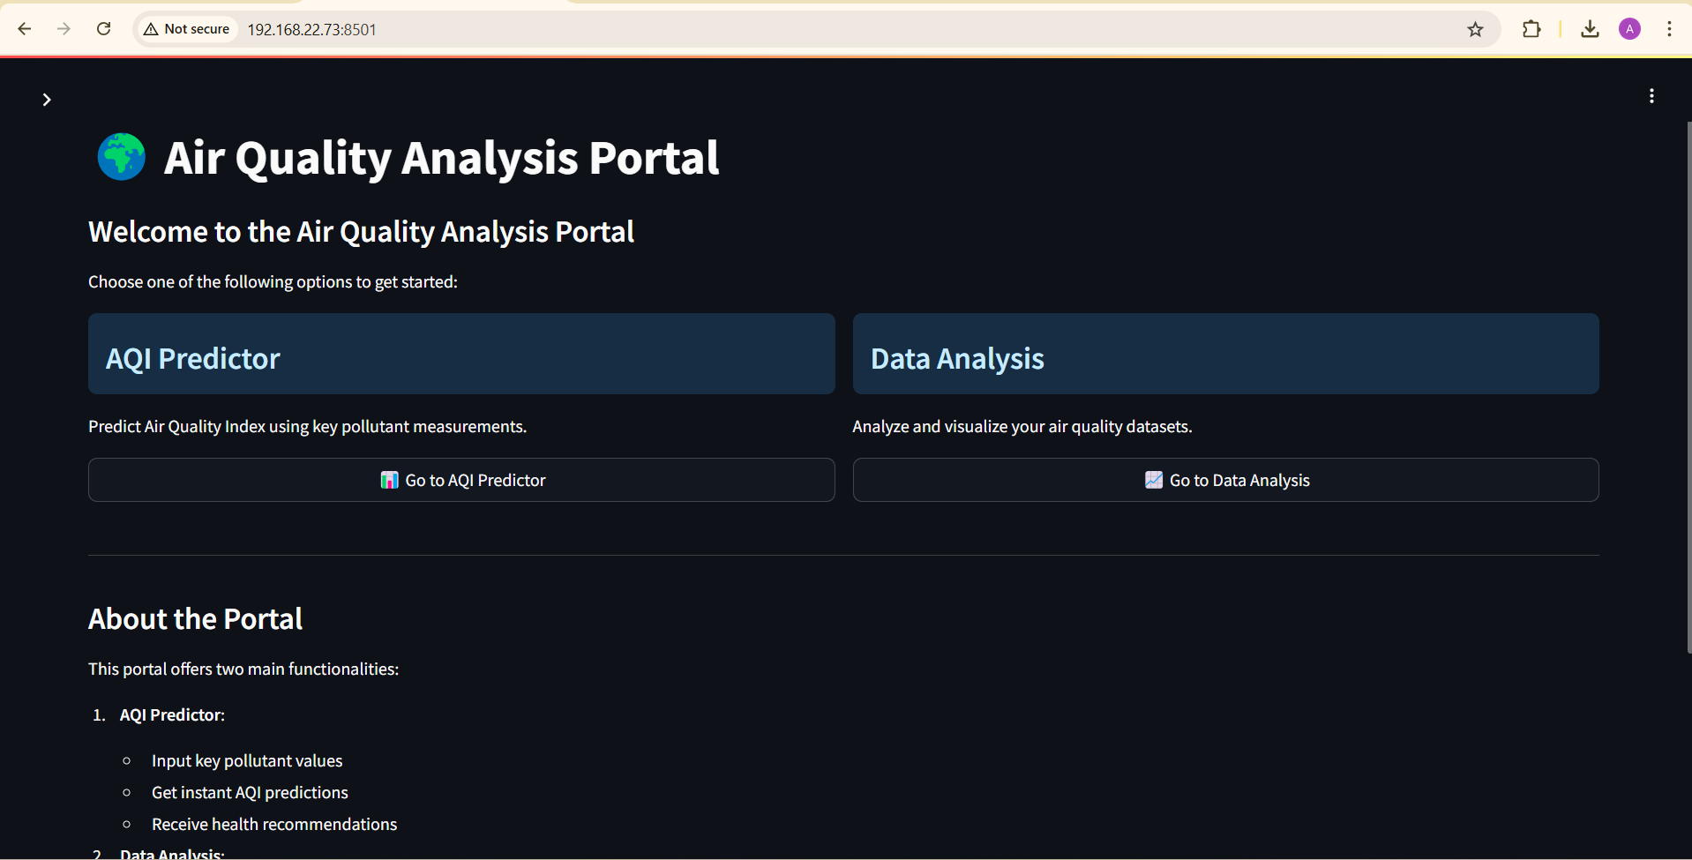
Home Page

Slide 10
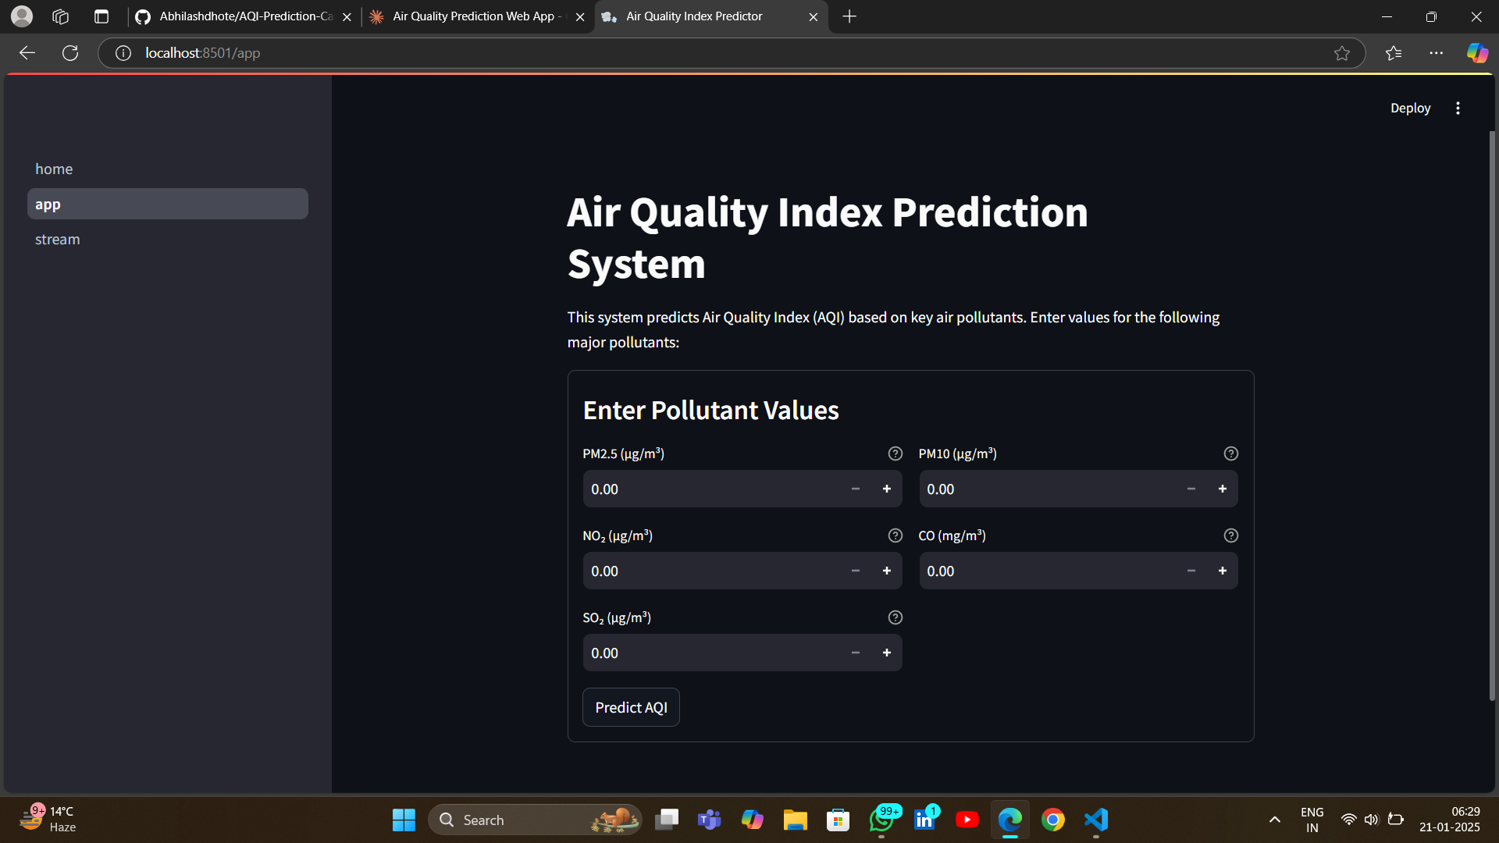
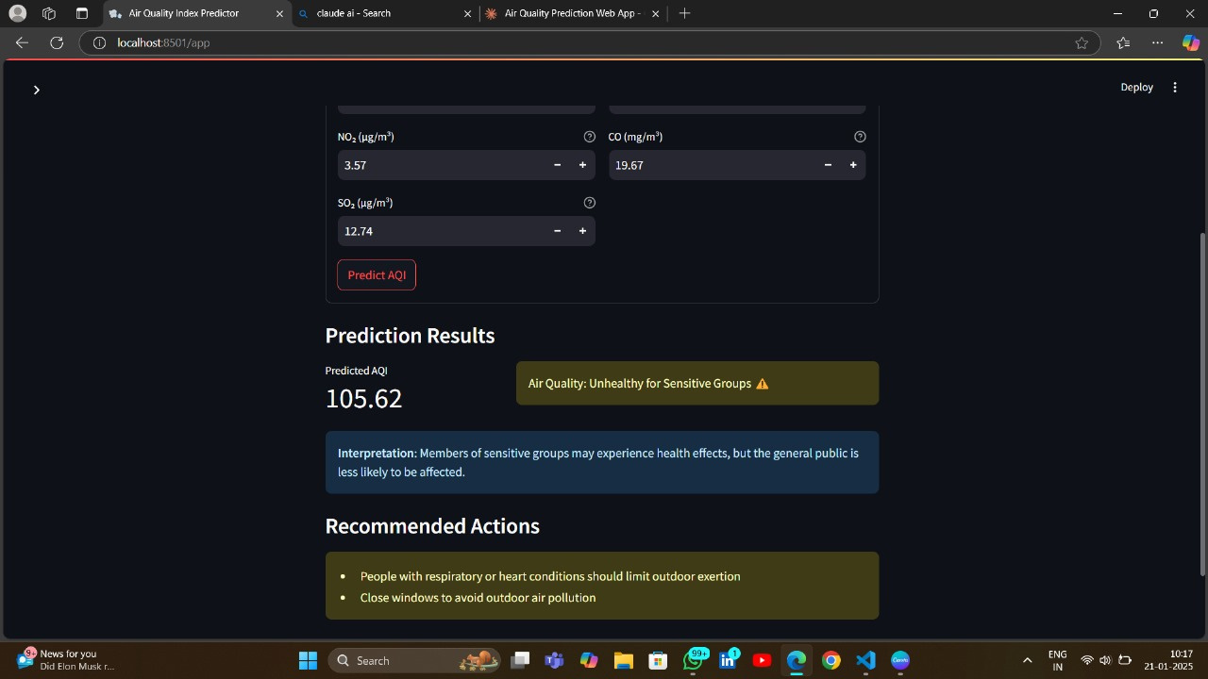

Slide 11
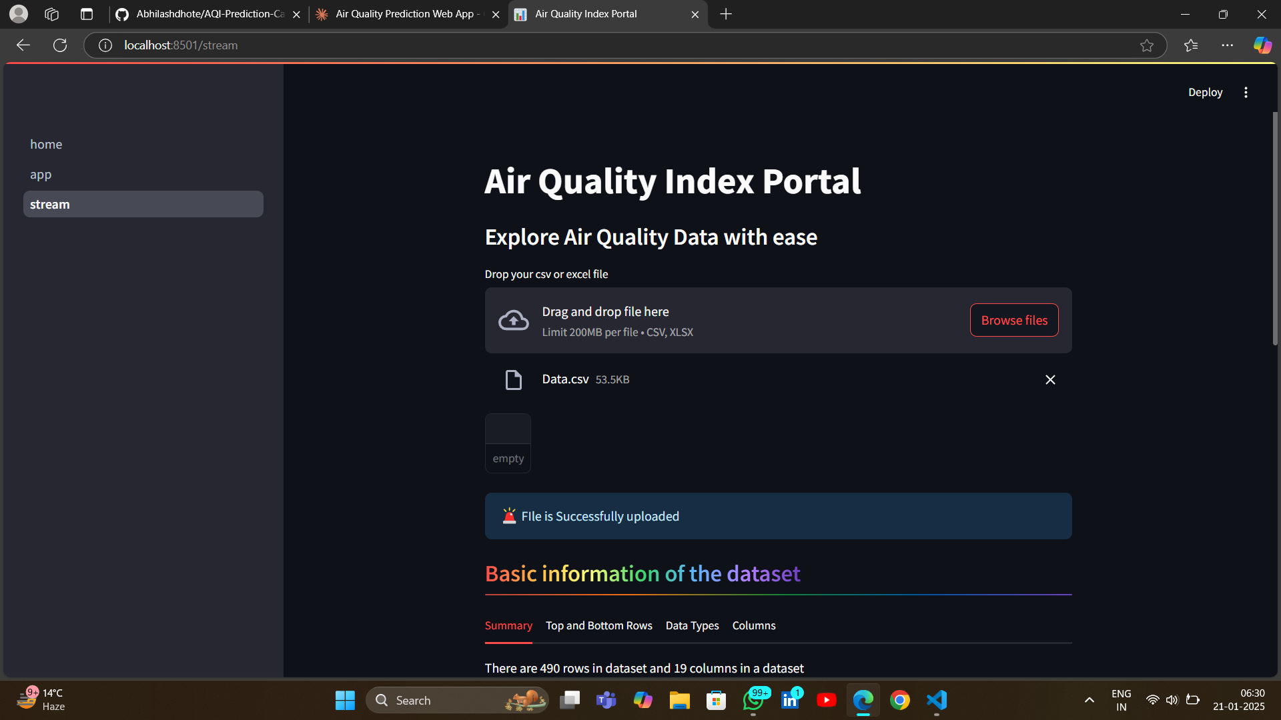
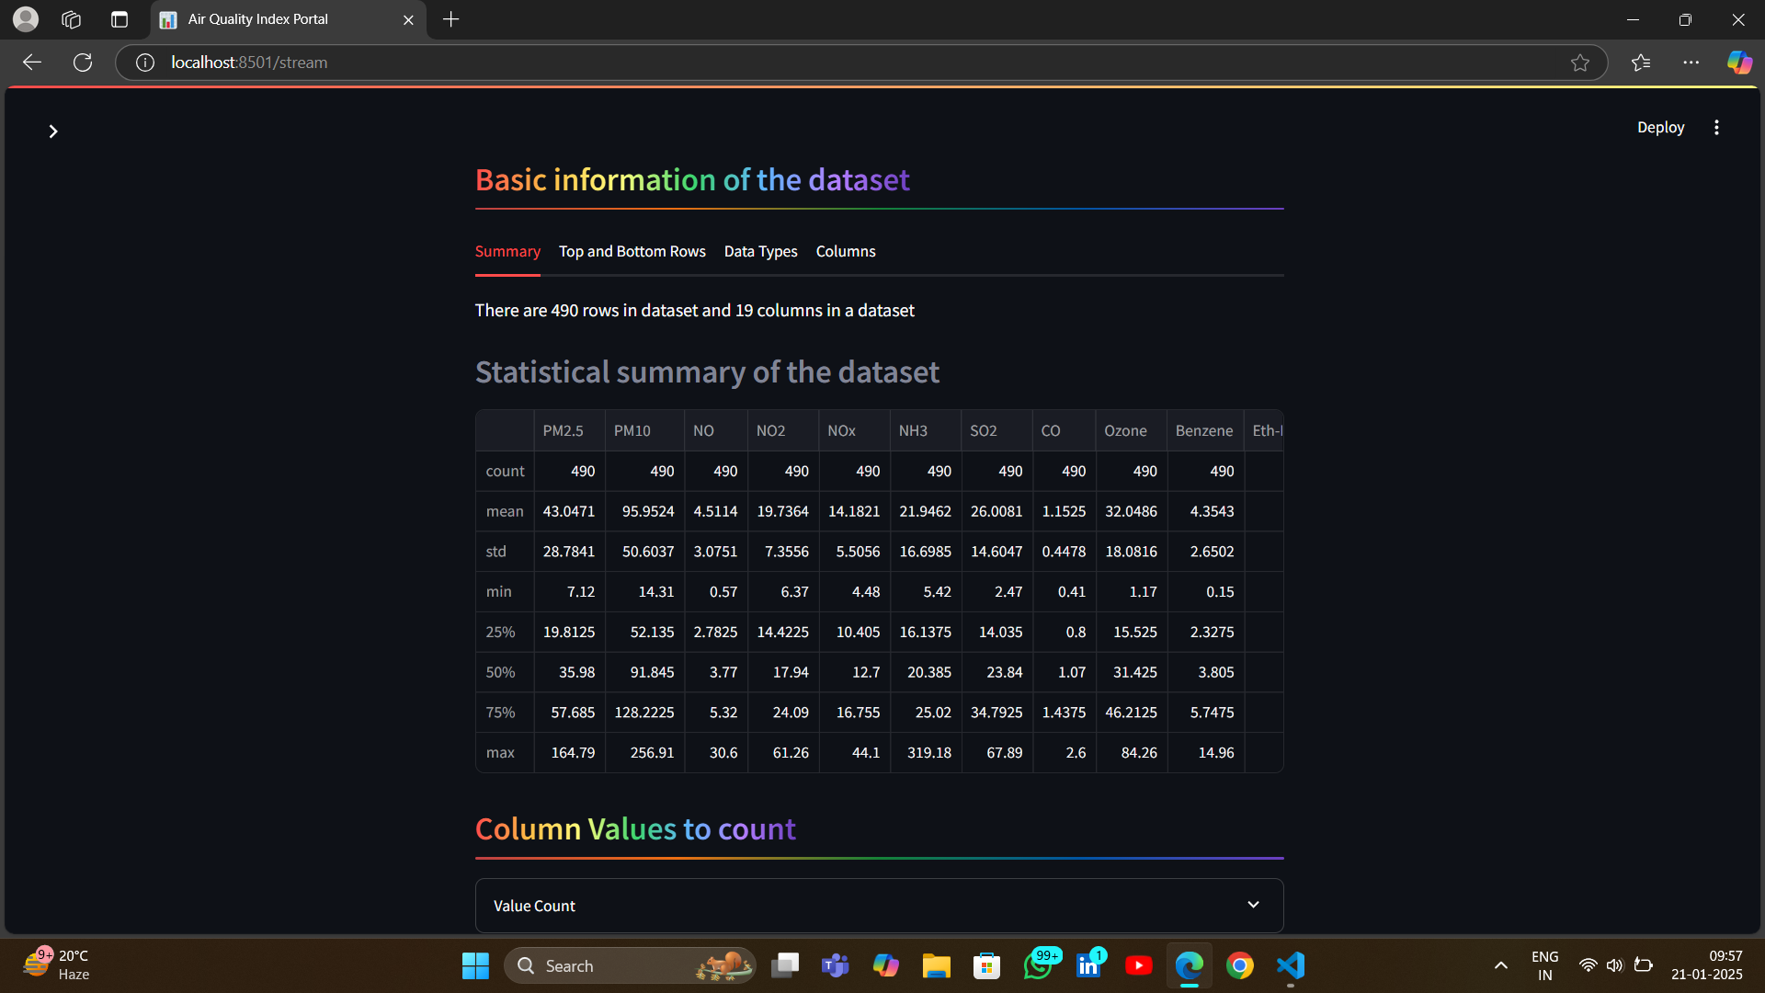

Slide 12



Technologies Used
Programming Language
Python 3.x
Web Framework
Streamlit (for web application development)
Machine Learning Libraries
scikit-learn (for Random Forest model)
NumPy (for numerical computations)
Pandas (for data manipulation)
Visualization Libraries
Plotly Express (for interactive graphs and charts)
Power BI
Development & Deployment
GitHub (version control)
Streamlit Cloud (deployment platform)
Git (source code management)
Data Source
CPCB (Central Pollution Control Board) API
CSV file handling

Slide 13


Uniqueness of Our Solution
Our web based app caters two important fields i.e Data Prediction along with Data Analysis and Visualization giving the user complete knowledge about the dataset he is predicting values with plus analysis of many more datasets.

Slide 14
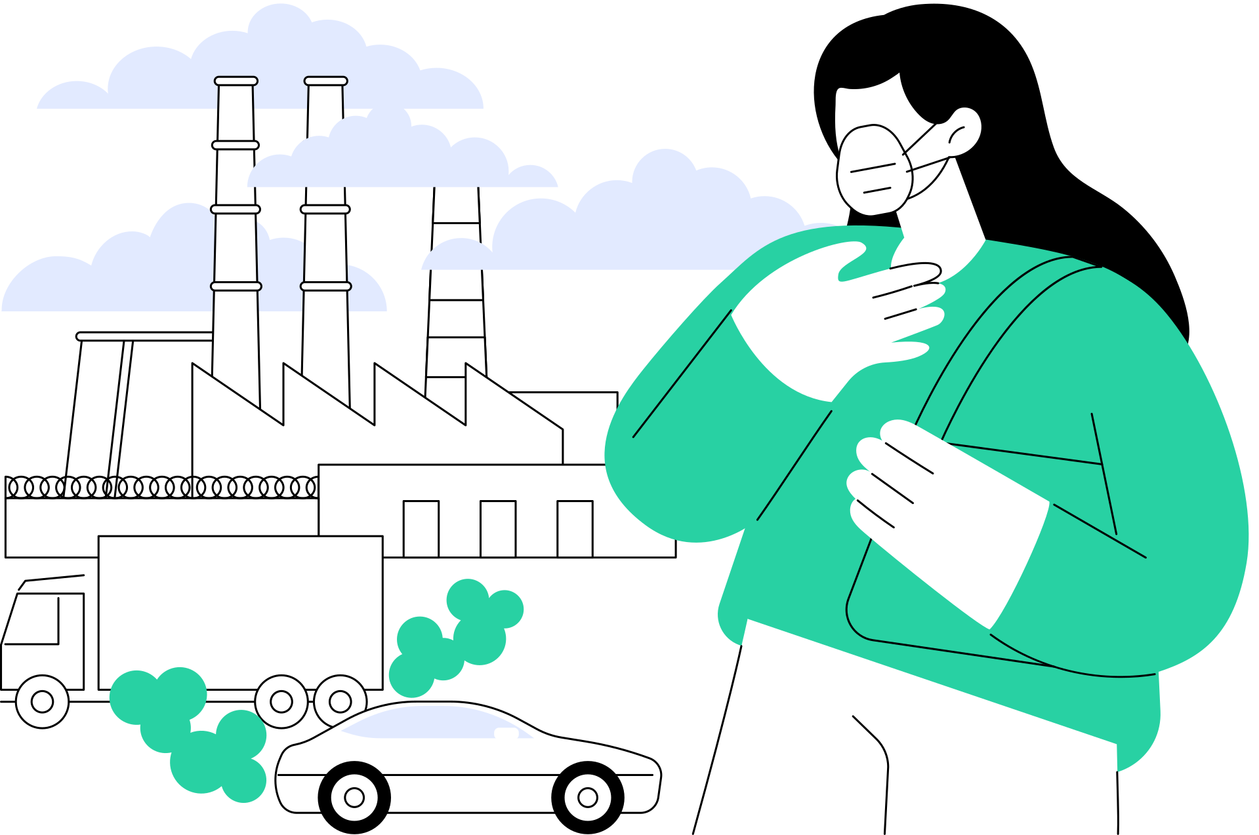
Thank you!
Presented by Career Craaft

